Slide 1
CoCo
Collaborative Collections
Austin Chustz, Jeff Garnier, Tom Kremer

Slide 2
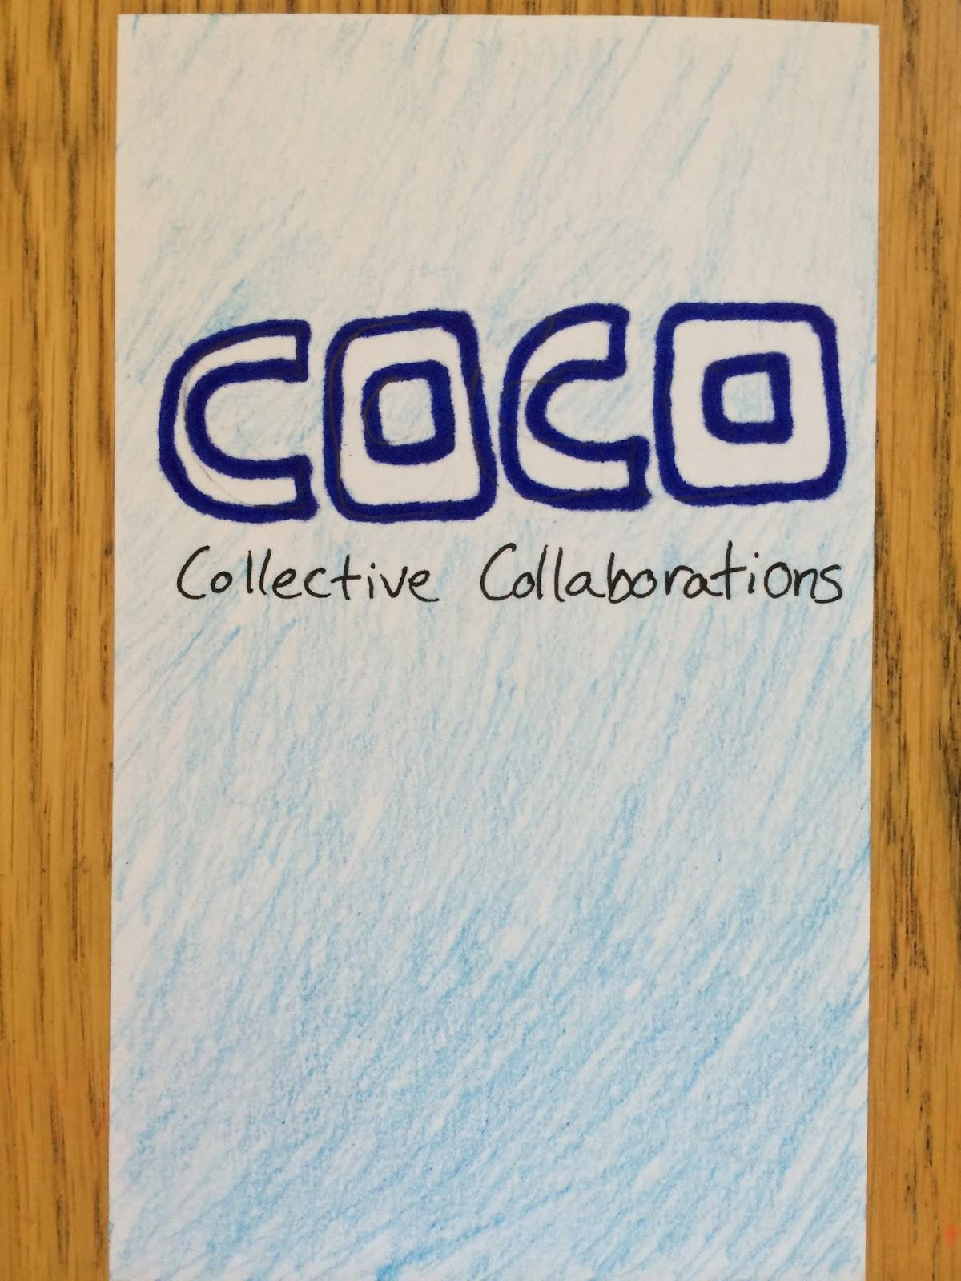
Overview
Important Tasks
Lo-fi structure
Experiment Results
Suggested UI Changes

Slide 3
Team Mission Statement
CoCo is a way to collaboratively create digital memories of events

Slide 4
Three Different Tasks
Task 1: Capture and share content
Task 2: View and vote on submitted content
Task 3: Share finished collections of content
Also, viewing upcoming events

Slide 5
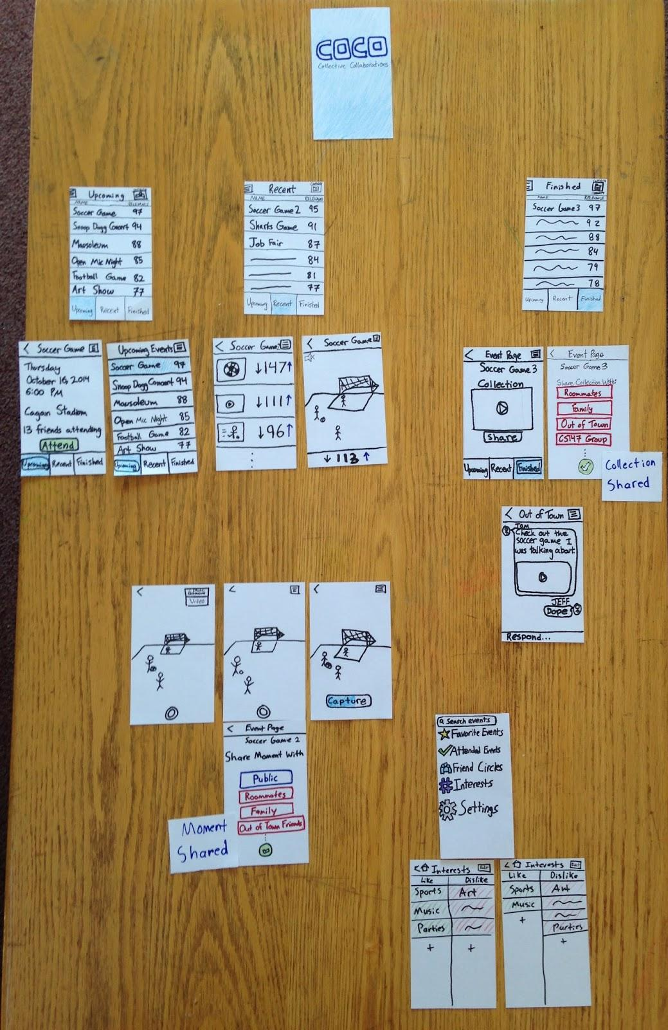
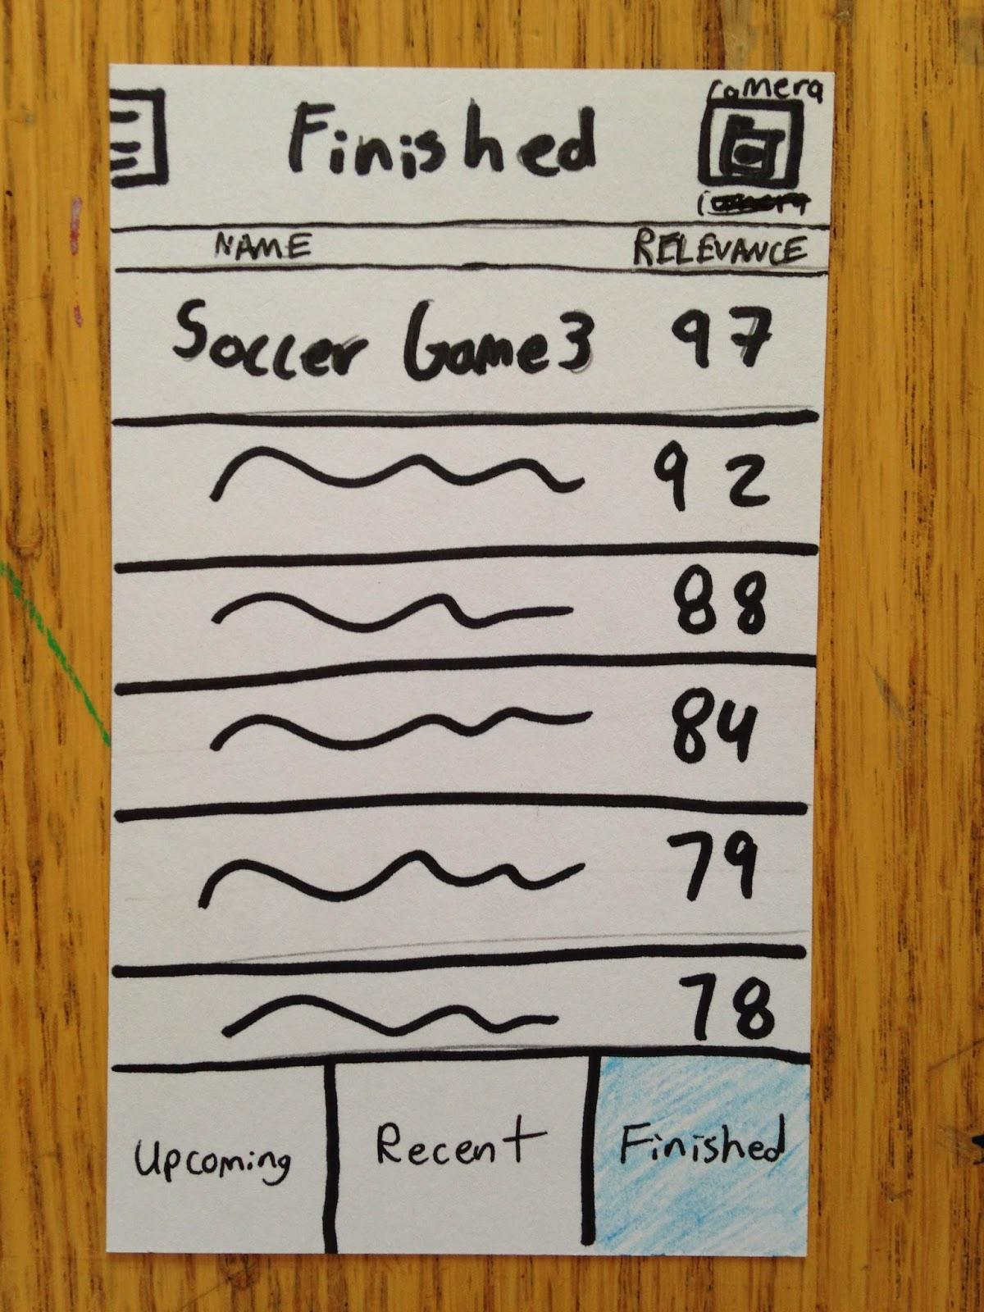
Lo-fi Prototype Structure

Slide 6
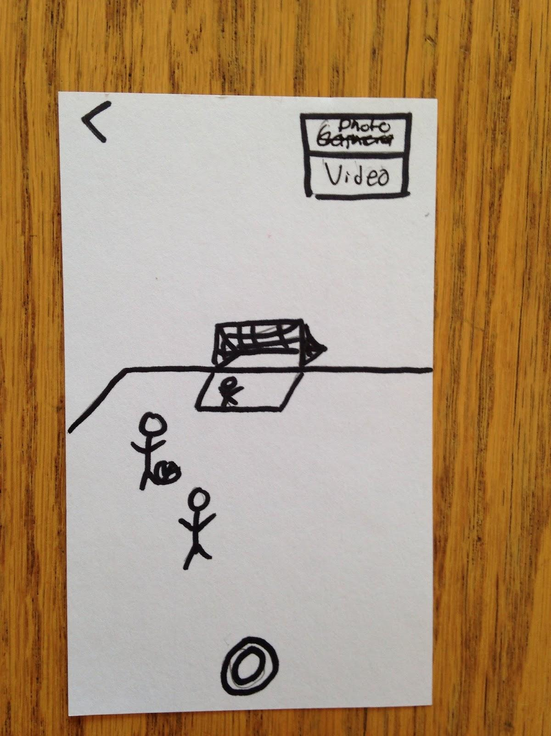
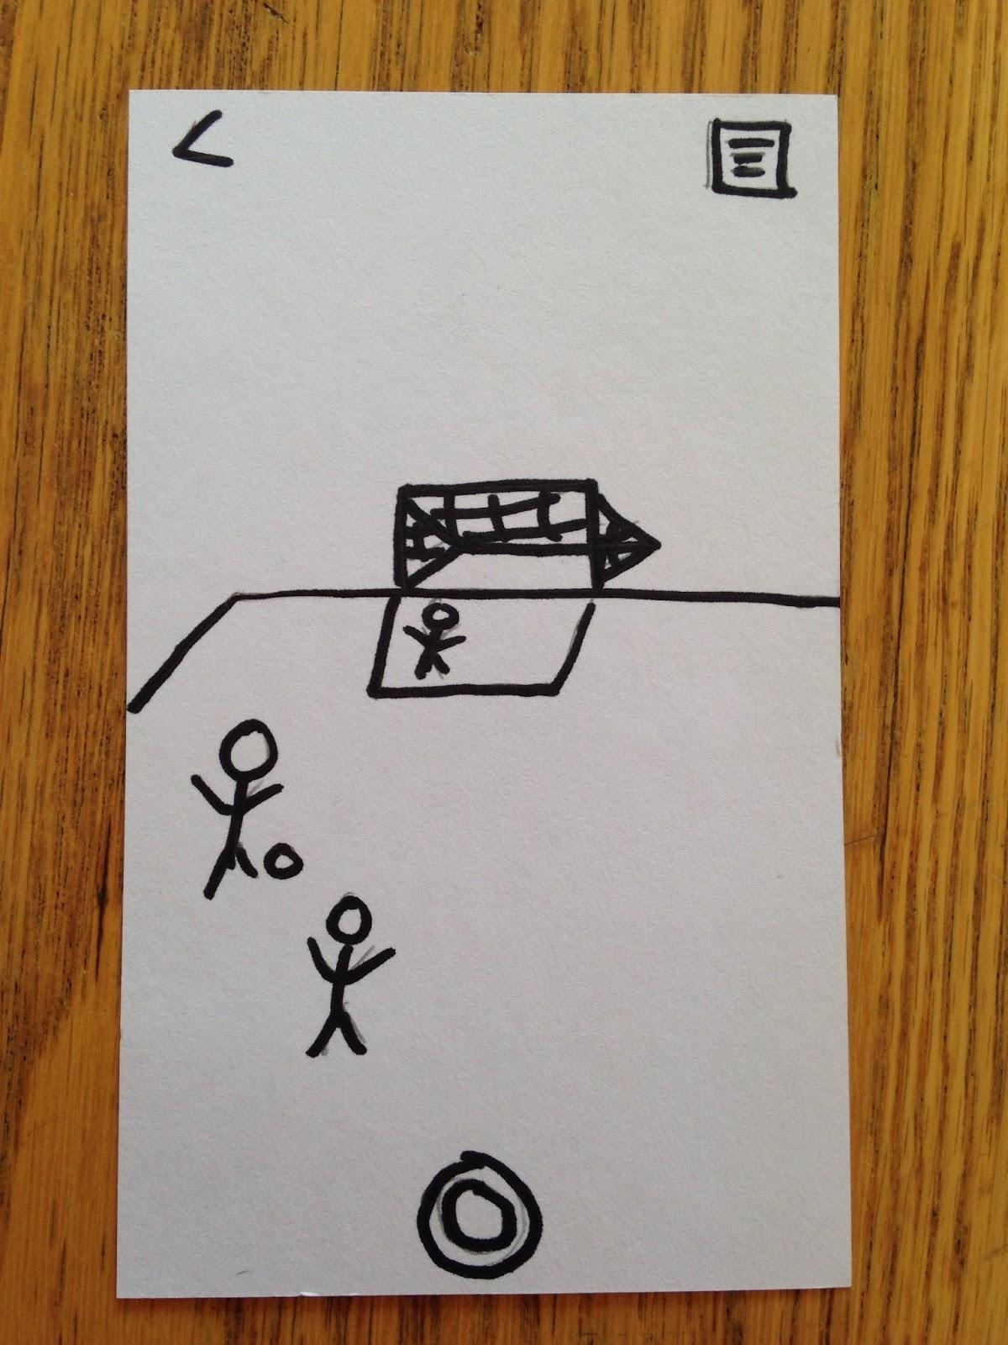
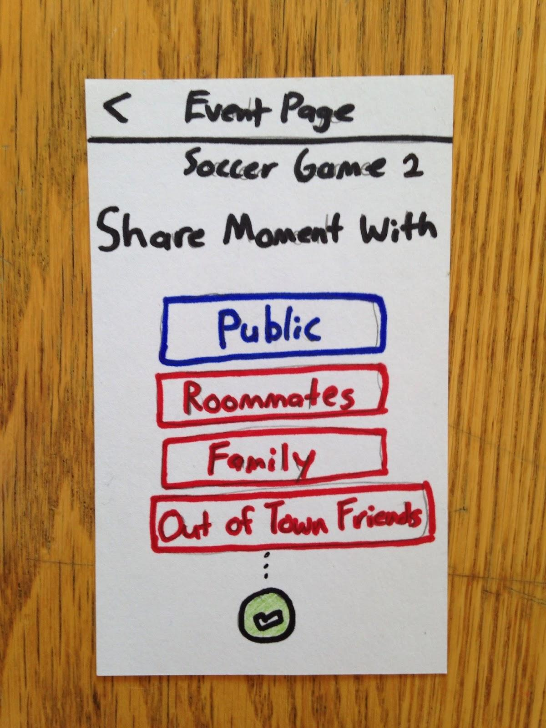
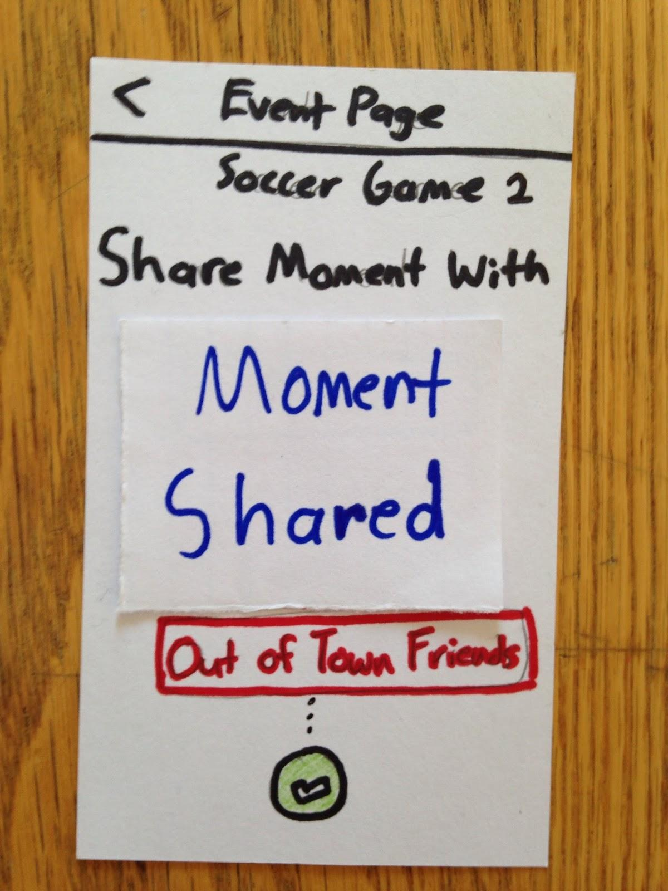
Task 1: Capture and Share Content

Slide 7
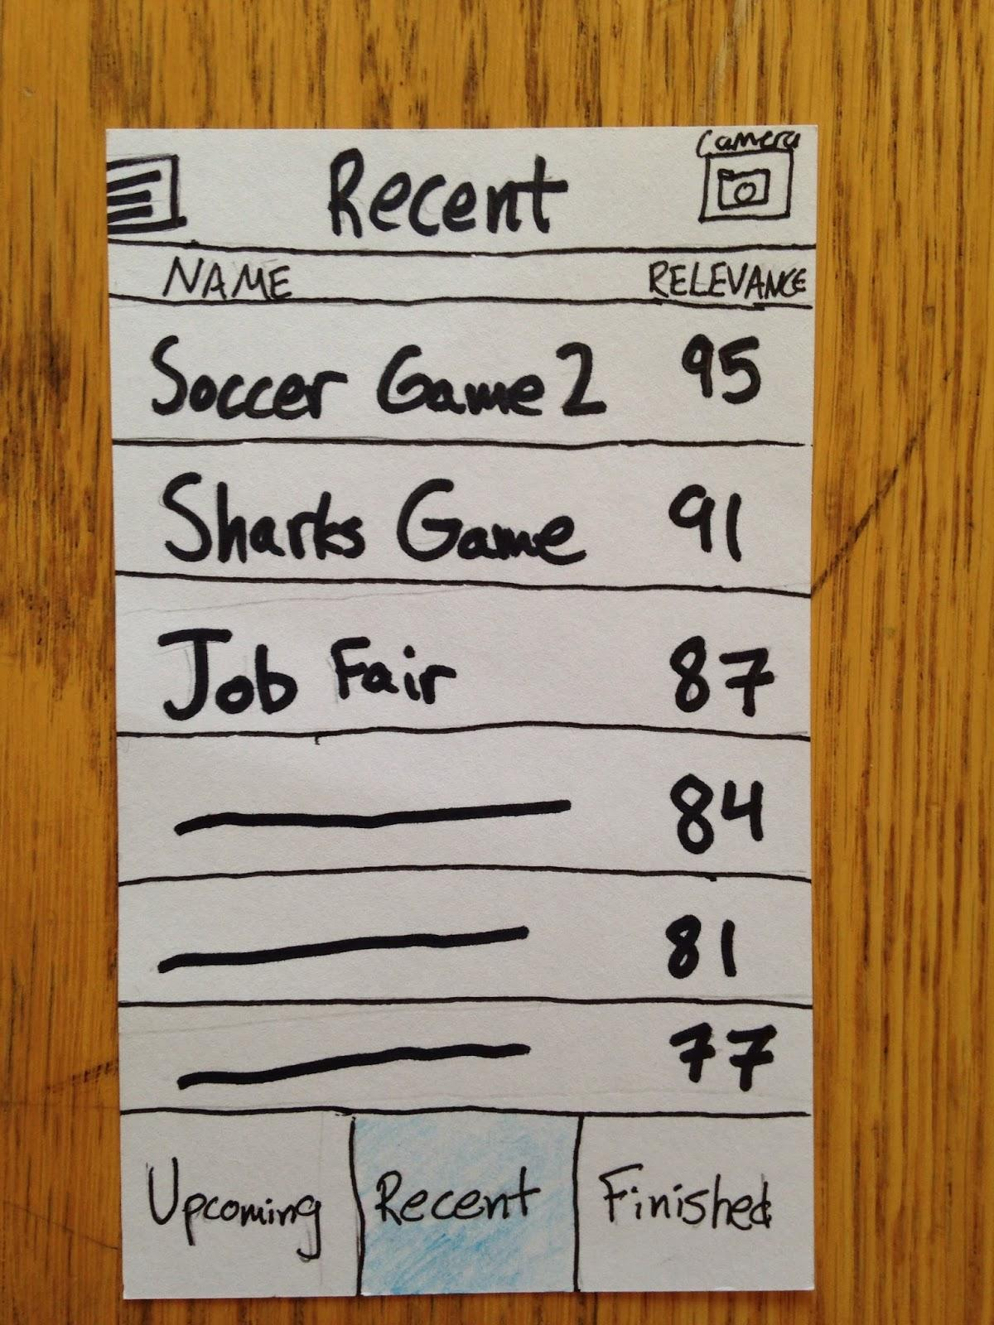
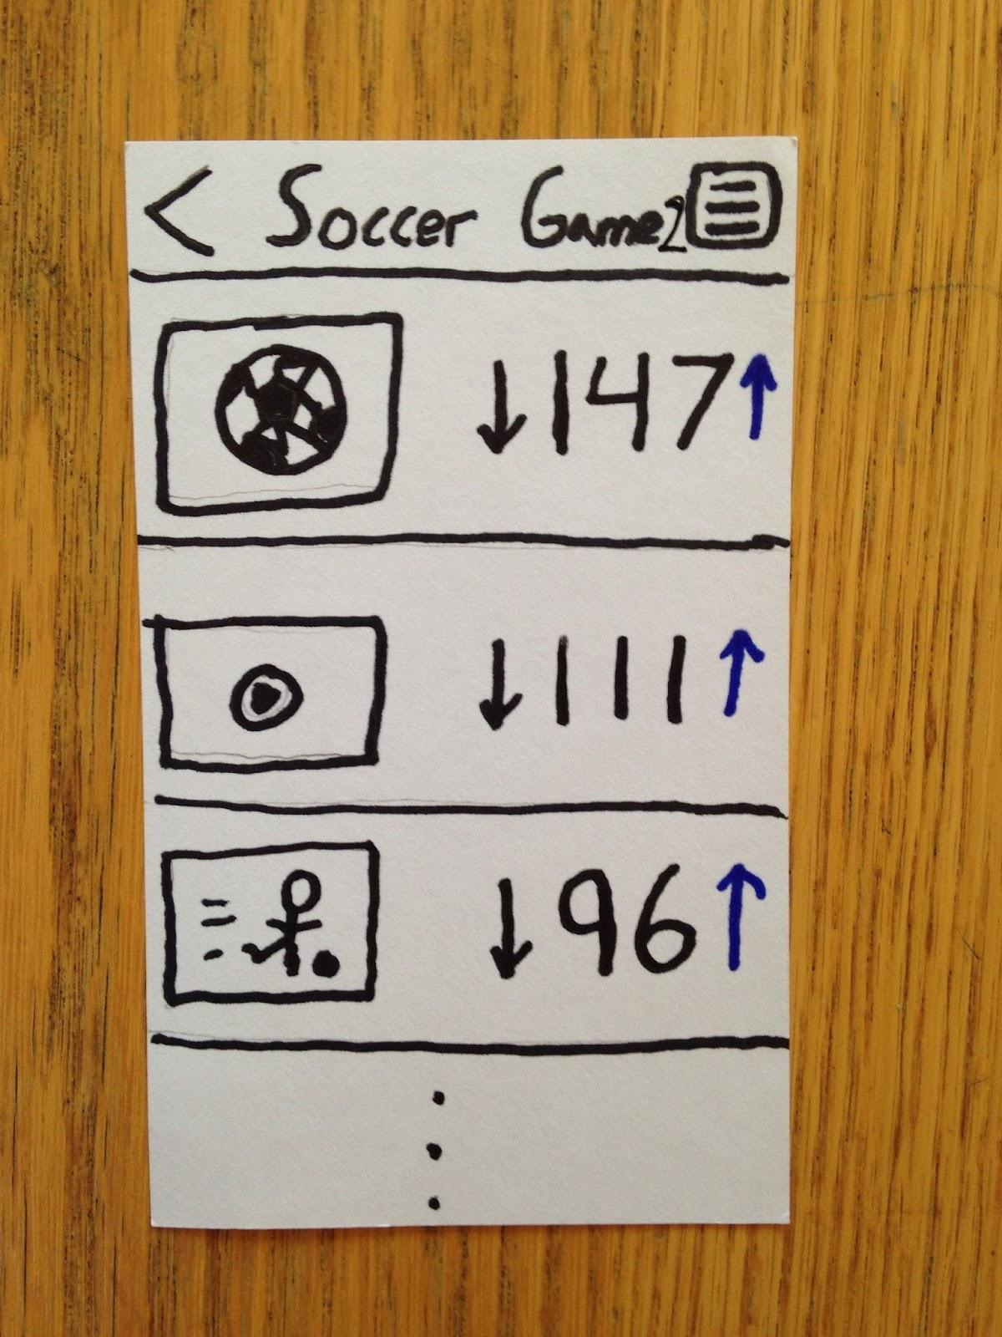
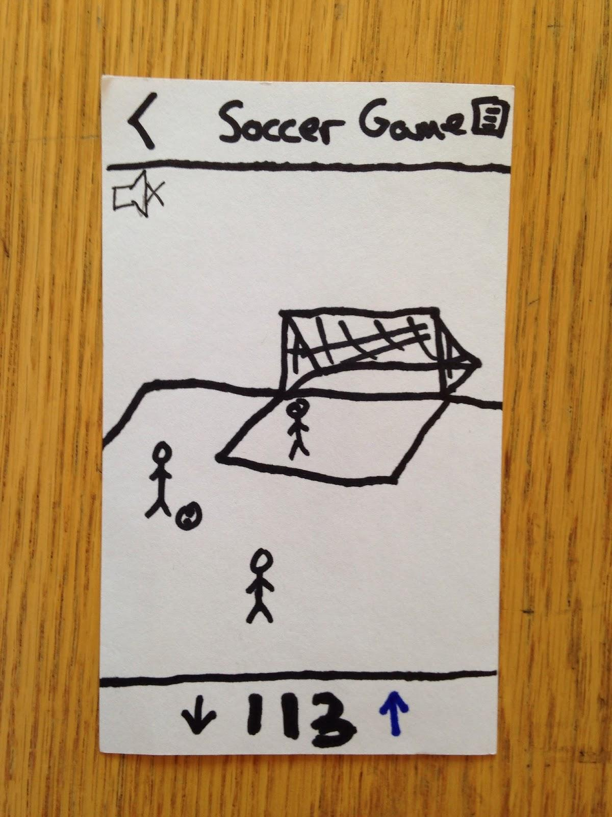
Task 2: View and Vote

Slide 8
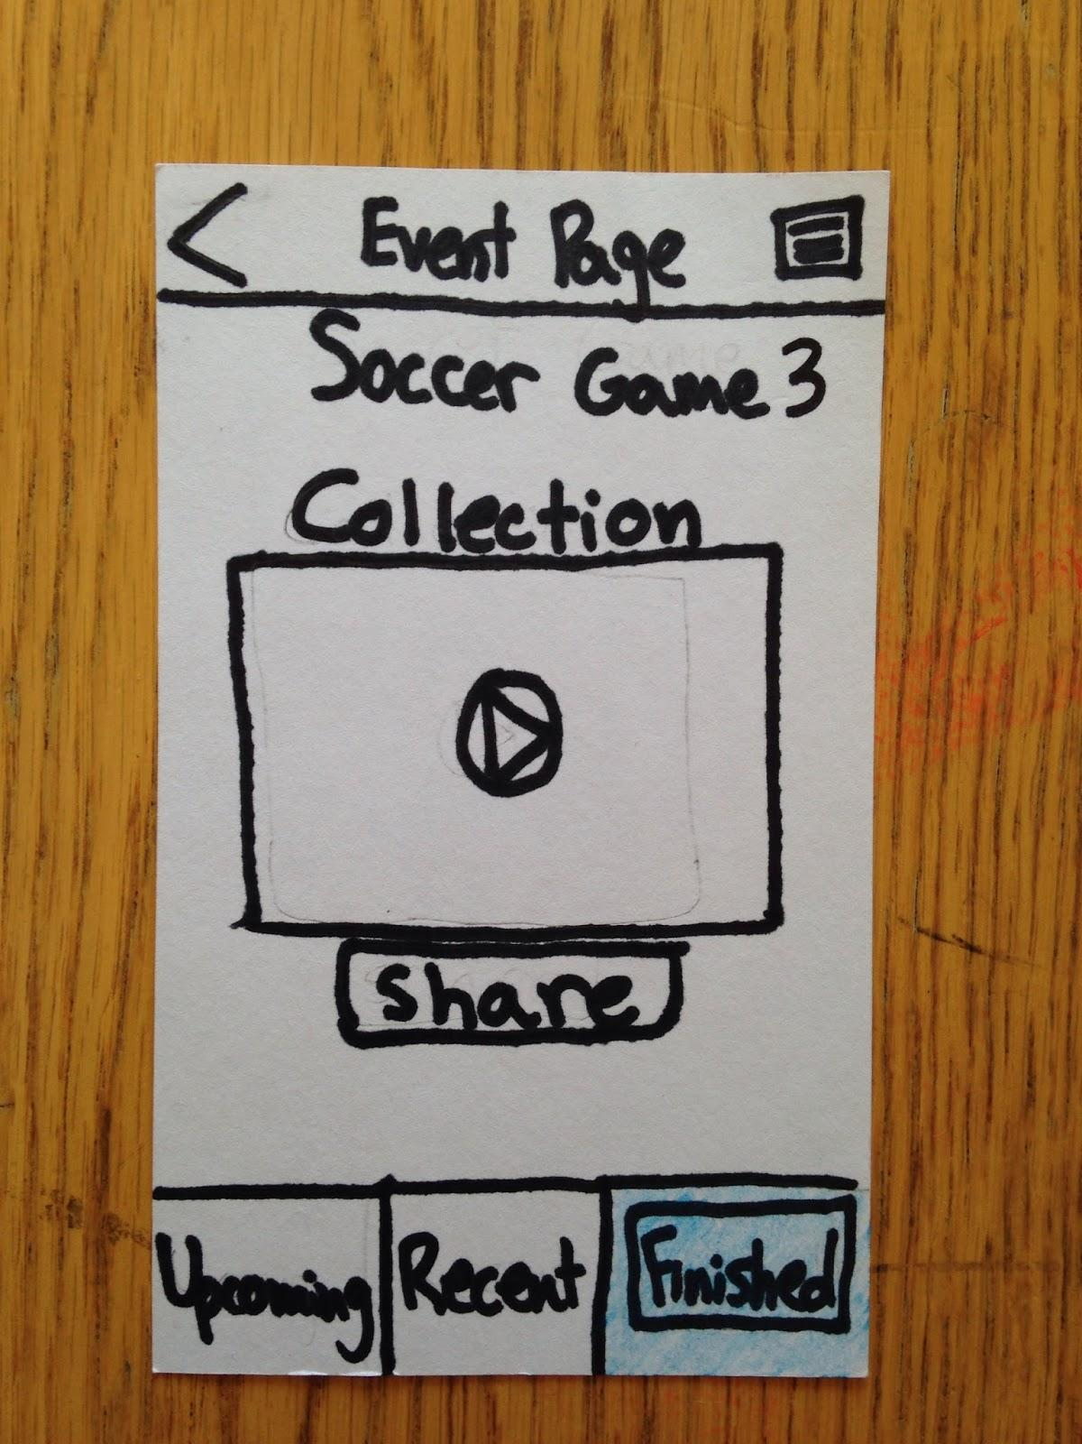
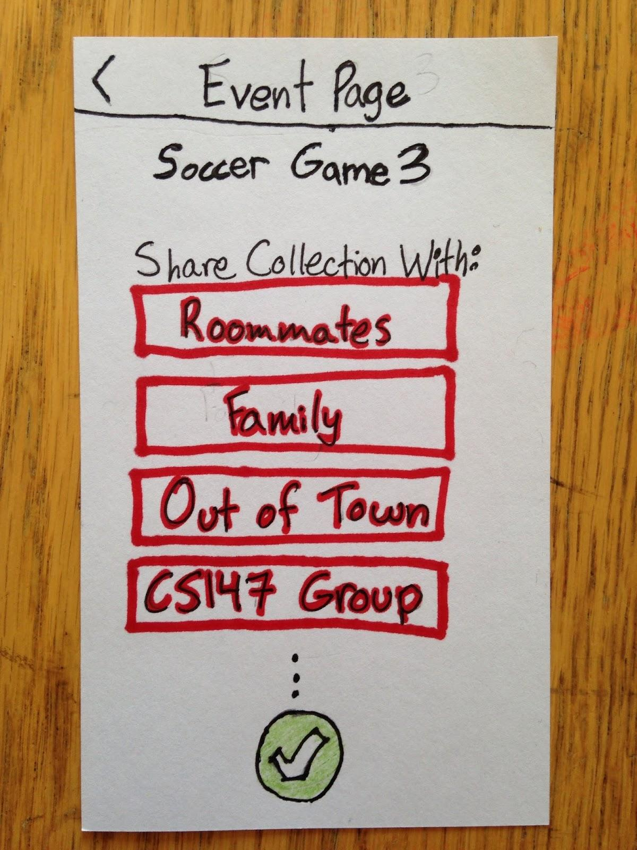
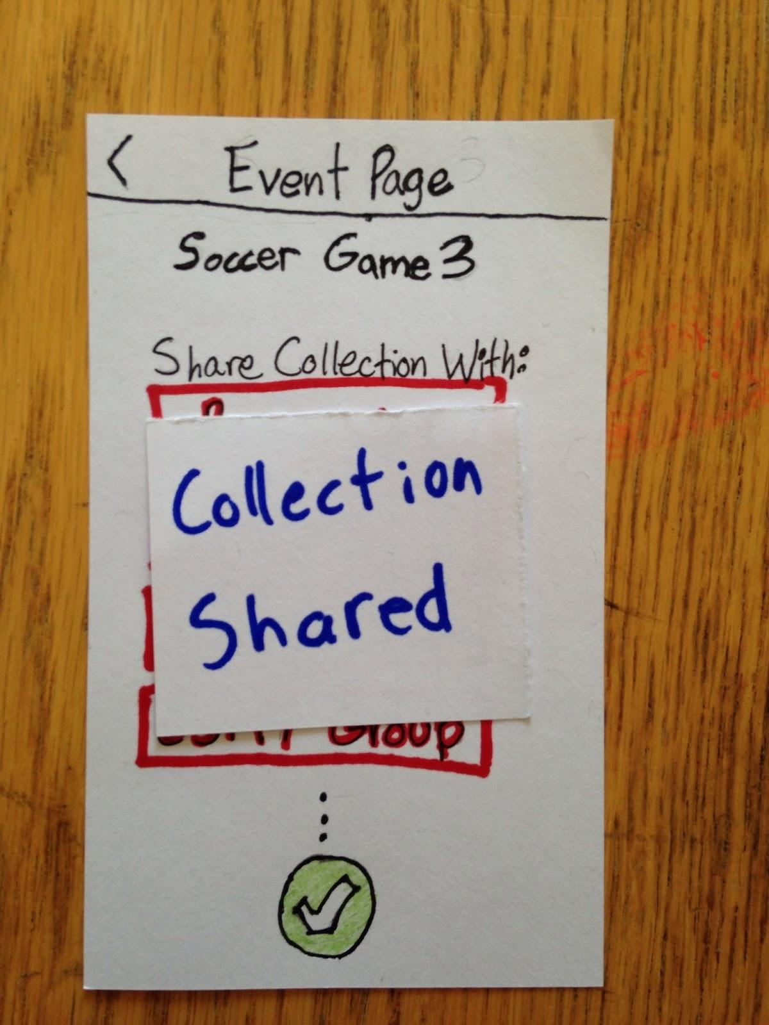
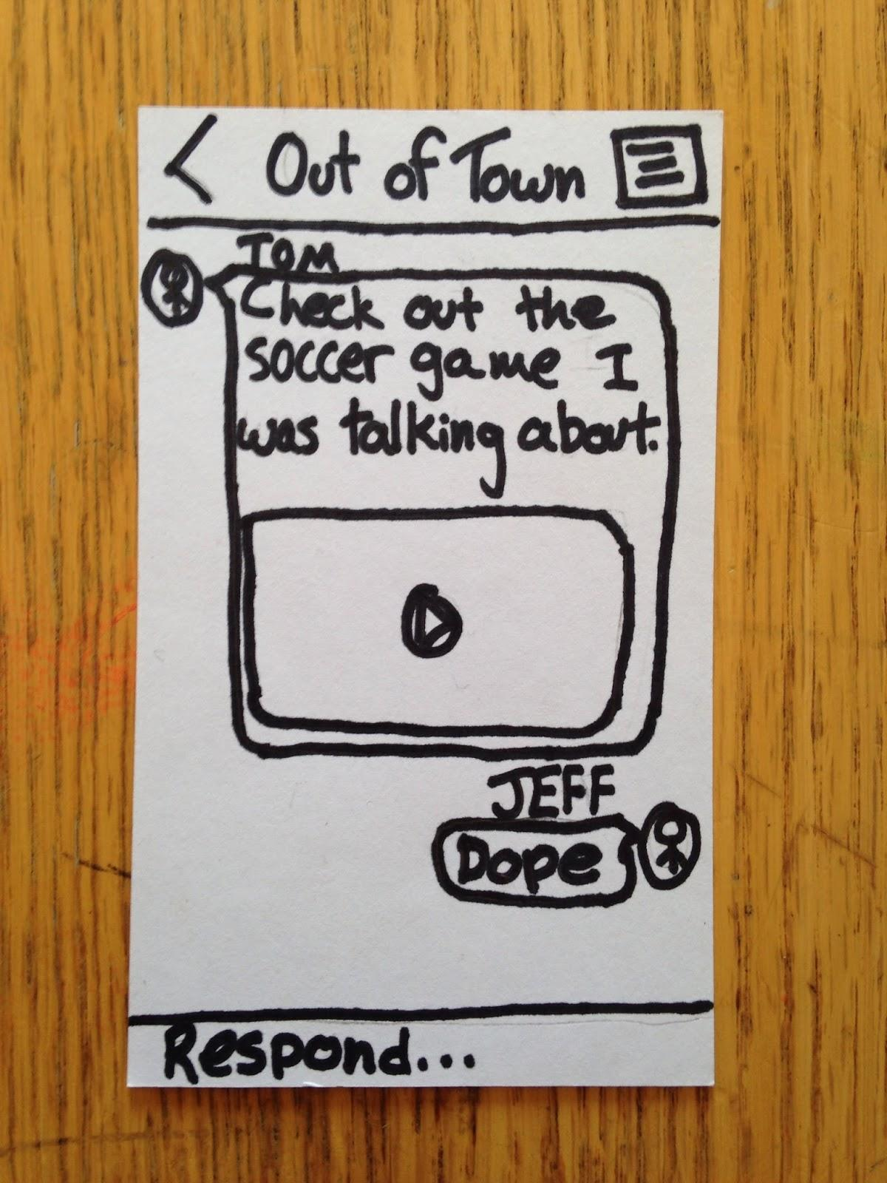
Task 3: Share Finished Collections

Slide 9
Experimental Method
One person at a time
Read script to them, ask if they understood
Present subject with home screen
Demonstrate unrelated task
Ask subject to do specific tasks (1, 2, or 3)
All questions that they asked were recorded
Most responses: What do you think?

Slide 10
Experimental Results
Task 1: Capturing and sharing moments
Confusion at home screen
“Am I adding to an existing event, or making a new event?” - subject 2
“I have to pick camera twice to take a picture?” - subject 3
Once task was initiated, things went more smoothly
“I’m guessing that I select any groups and click the green checkmark to send” - subject 2
Confusion: “What does it mean to share with public?” - subject 1

Slide 11
Experimental Results
Task 2: Viewing and Voting on Submitted Content
Some slight confusion from recent vs finished events
Afterwards, things went perfectly
“Can I vote without even viewing the clip?” (yes) “Oh sweet I’m going to downvote all of them” - subject 2
“This one was actually pretty intuitive” - subject 1

Slide 12
Experimental Results
Task 3: Viewing and Sharing Finished Collections
Confusion over how Collection is made
Also whose content is picked (own, friends’, public)
“I’m glad I can watch it first to see if it’s even worth sending” - subject 1

Slide 13
Suggested UI Changes
Noticed that Camera icon was not very noticeable
“Maybe put ‘New Moment’ above the camera so I don’t try to create a new moment through different tabs” - subject 2
“How do I change my mind about attending the event?” - subject 1
We need a way to “unattend” events too

Slide 14
Suggested UI Changes
Confusion between Recent and Finished tabs
“Are recent events finished? Or still ongoing?” - subject 1
Change names: Recent → Voting, Finished → Archived
Have ability to share upcoming events
Let friends know about event ahead of time
Notification system

Slide 15
Summary
Subjects were uncomfortable at beginning of first task
Quickly learned how to navigate after initial confusion
Tasks 2 and 3 had fewer issues than task 1
Make capturing content easier
Adding a few small features can create better experience
Notifications, renaming tabs, unattend

